Slide 1
You Spilled Cloud In My DevOps

Slide 2
Chicago VMUG Leader
Blog: theITHollow.com
Twitter: @eric_shanks

Slide 3

Double VCDX # 195 – DCV/CMA
Senior Solutions Architect for AHEAD

Slide 4
This Session
Notes:
When asked to talk about things…
Sometimes we’re afraid to ask questions because we fear everyone already knows the answer. We also won’t volunteer to speak about things because we’re scared what other people will think of our skills.
This session is covers a series of concepts that we talk about but many people may not know what the are and why they’ve come about and might be to scared to take a second to ask the questions about.

Slide 5

Do We Really Need To Go Faster?
Notes:
Businesses want to go faster.
Deploy from Template only takes 15 minutes.
DBA would get his new VM Deployed within a couple of hours within the request.
Self Service portal only really saved 30 minutes or so.
Is this just a sales pitch to sell new software?

Slide 6
Do Developers Have Slow Processes?

Slide 7

Notes:
Programming Request wouldn’t look like what was asked for.
Users ask for something and find out they don’t want it
Developers misunderstand the requirements

Slide 8
Introducing Agile!
Phineas - The Original Scrum Master
No Waterfall Process
Iterate Quickly
Get Feedback Quickly
Iterate Again
Continuous Integration
Fail Fast

Slide 9

Agile Needs Resources Quickly!

Slide 10
Does Operations Have Slow Processes?

Slide 11
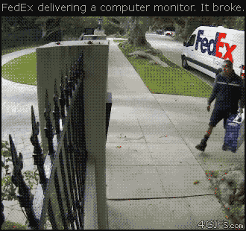
Throw It Over The Wall Approach
Notes:
Throwing it over the wall approach is too slow.
Dev Throws over wall to Server Team, Server Team to Backup Team, network team to monitoring team.

Slide 12








Traditional Provisioning Takes Too Long for Agile!
Order Request
Order
(Testing)
IP Request
Backup Request
Developer
Server Team
Order
IP Address
Security
Networking
Security
Request
Monitoring
Request
Monitoring Team
Backup Team

Slide 13

Troubleshooting Takes Too Long!!!!

Slide 14
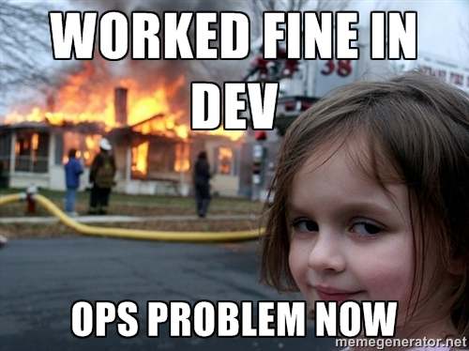
Shift the Problem

Slide 15
Introducing DevOps

Slide 16

How Do We Tear Down The Walls?
Go Full Stack
Consolidate Teams
Automation

Slide 17

Do We Tear Down The Walls with Full Stack?
IIS
Azure
Python
Active Directory
Linux
Git
Networking
vSphere
PowerShell
NGINX
Storage
SQL
Windows
MySQL
vCloud Air
PHP
Apache
AWS

Slide 18



Do We Consolidate Teams?
Development
DEVOPS!!!
Operations

Slide 19


Automation Enables Development
Containers
APPLICATION
AUTOMATION
INFRASTRUCTURE AUTOMATION

Slide 20
Approach to Building IT Services
PRIORITIZE
STANDARDIZE
CREATE PROCEDURES
AUTOMATE
PUBLISH

Slide 21

How Does Cloud Fit Into this?
Essential Cloud Characteristics
  Self-Service
  Heavily Automated
  Resource Pooling
  Elasticity
  Measured/Metered
  Infrastructure As Code

Slide 22















How Does a Cloud Come Together?

Slide 23

What Do We Need to Automate?
Cloud/Lifecycle Management
Orchestration
Configuration Management
Notes:
Cloud Management Portal, Orchestration, Configuration Management

Slide 24
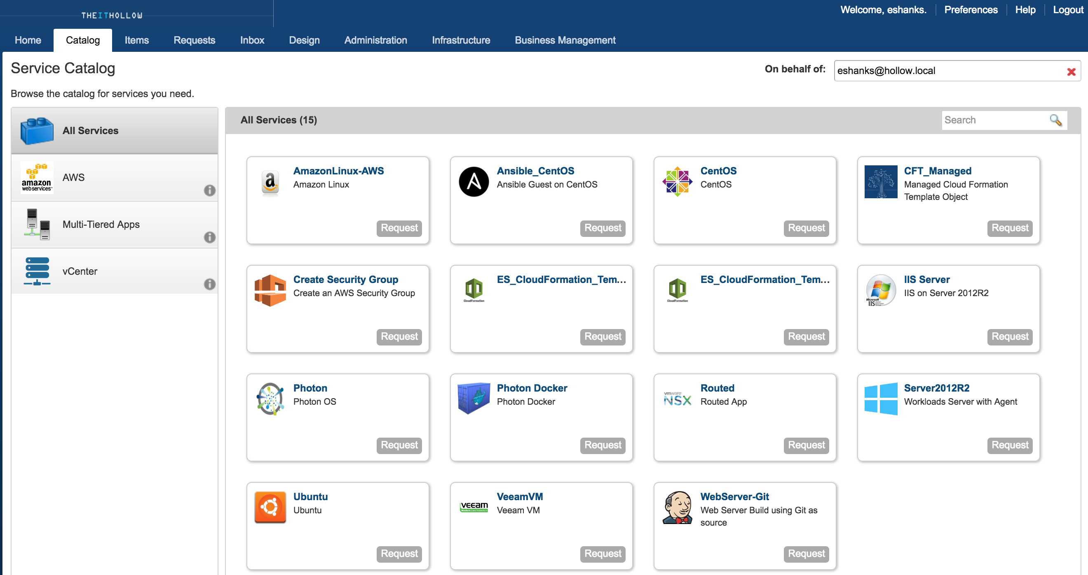
Cloud Management Portal

Slide 25
Life Cycle Management
REQUEST
ARCHIVE
APPROVAL
Provisioning must be thought of in the context of the entire lifecycle of the application or service
RETIRE
PROVISION
MANAGE

Slide 26
Chargeback and Show back

Slide 27
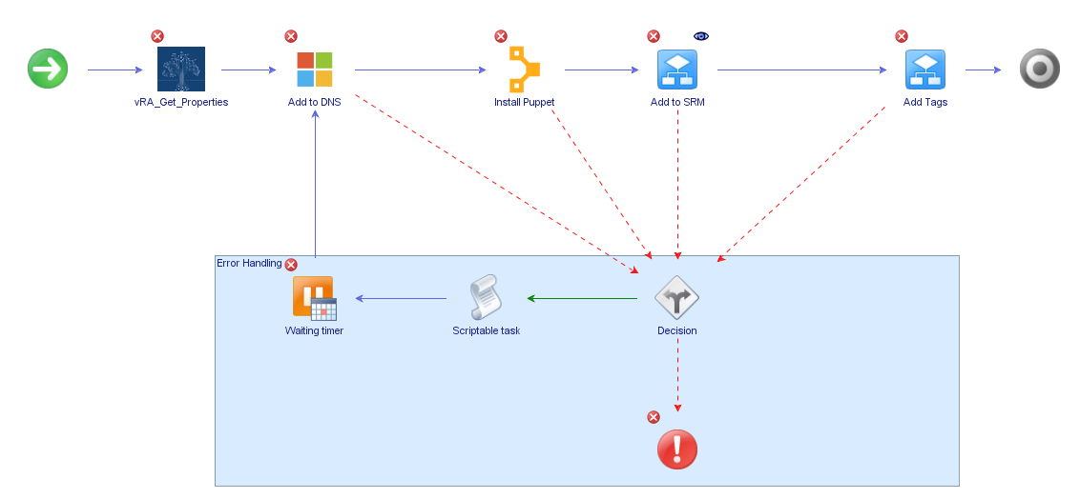
Orchestration

Slide 28
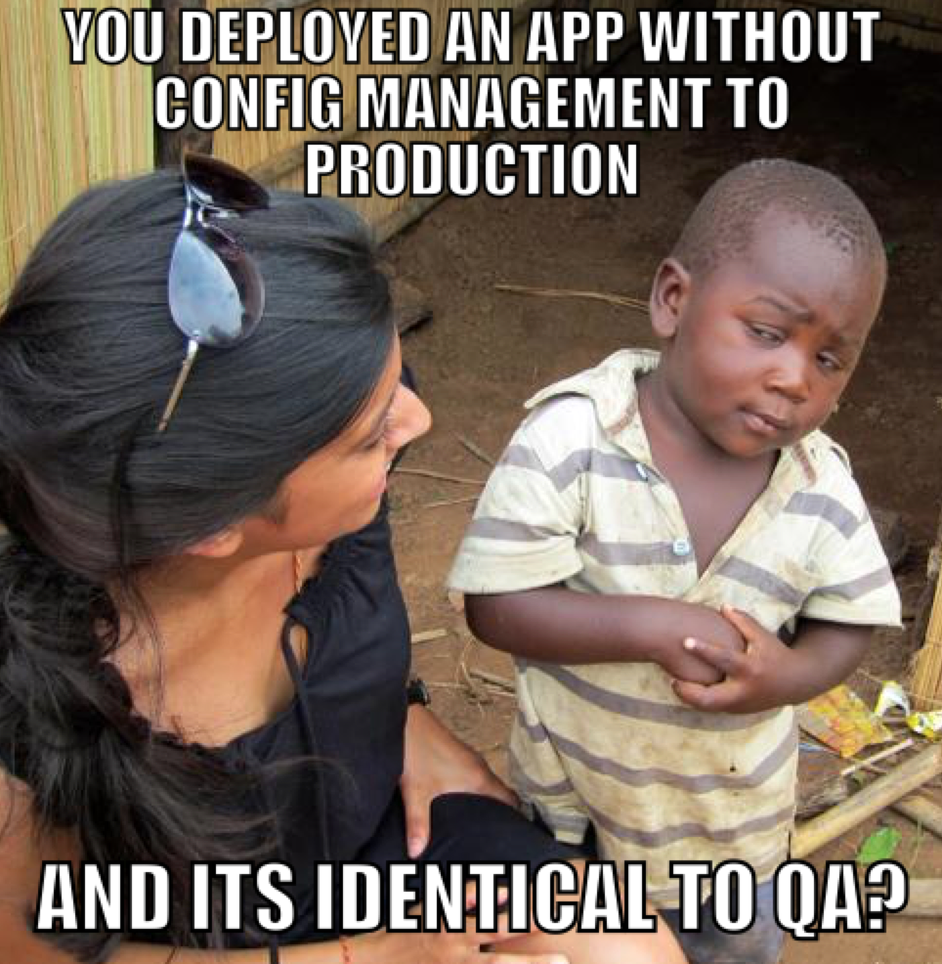
Configuration Management
Configuration Management Benefits
  Manage Drift
  Infrastructure as Code
  Application Deployments
  Repeatability

Slide 29
Infrastructure as Code
Modules
WINDOWS
(BASE OS)
LINUX
(BASE OS)
SQL
SECURITY
APACHE
WEB SERVER
IIS
WEB SERVER
Compose Application Stacks
Role: SQL Server

Slide 30





What Do I Have Now?
BUILD
Destroy
✓
✓
Cloud Management Platform

Slide 31





How Do We Leverage our Automation Solution?
Cloud Management Platform

Slide 32
How Do We Leverage our Automation Solution?
API Call
Automatic Approval
Manual Intervention

Slide 33
Topics We’ve covered
Agile
Continuous Integration
Continuous Development
DevOps
Cloud
Orchestration
Configuration Management

Slide 34
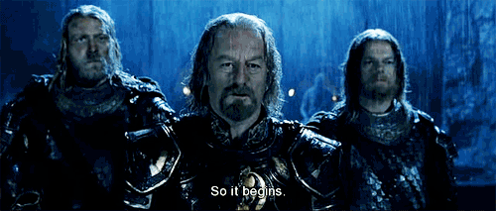
Where Do I Get Started?
https://learn.chef.io/tutorials/
https://www.ansible.com/get-started
https://learn.puppet.com/category/self-paced-training

Slide 35

Where Do I Get Started?

Slide 36






Where Do I Get Started?

Slide 37

It’s OK if You Don’t Know Everything

Slide 38

So Yes! We do Need to Go Faster

